Slide 1
Semantic Plagiarism Detection and Idea Validation Using RAG-Based Embeddings Dharaniraj VM (2022115058) Jayasuriya R (2022115031) Sivasankaramoorthy R(2022115032)

Slide 2
01
Introduction

Slide 3
Is an idea truly original, or has it been explored before? Many institutions still rely on manual checks or expert reviews, making the process slow and subjective. Our system automates this by semantically analyzing thesis papers against a database of existing research.
Using Retrieval-Augmented Generation (RAG) and embeddings, we move beyond keyword matching to detect conceptual similarities, even when phrased differently. If a match is found, the system retrieves key details like the author, year, and project information, ensuring academic integrity.
Plagiarism isn't always intentional—many students unknowingly work on previously explored ideas. With no proper originality-checking system, universities face repeated project submissions. Our solution prevents duplication while inspiring students to develop truly innovative research.

Slide 4
02
Problem Statement

Slide 5
Problem Statement
Validating the novelty of a thesis is a critical yet challenging task for academic institutions and PhD scholars. Universities and research committees often struggle to efficiently verify whether a submitted thesis presents a truly original contribution or if similar research already exists.
The current process of manually reviewing extensive academic literature is time-consuming and tedious, making it difficult to ensure academic integrity.
For PhD scholars, selecting a unique research problem is equally challenging. Existing plagiarism detection solutions primarily rely on keyword matching, which fails to capture semantic similarities between research topics, making them ineffective in identifying reworded or conceptually similar work.

Slide 6
03
Social Relevance

Slide 7
Social relevance:
ADDRESSING CHALLENGES IN ACADEMIC RESEARCH:
Validating the novelty of PhD theses is a complex and time-consuming task for universities. Our system automates this process using advanced embedding-based retrieval, ensuring a more accurate and efficient validation of thesis originality.
PREVENTING REDUNDANT RESEARCH
Many PhD scholars unknowingly choose topics that have already been explored, leading to wasted time and effort. By providing a semantic similarity check, our system helps researchers identify whether a similar study already exists. This ensures that scholars can either refine their ideas or choose a truly novel research problem, fostering meaningful academic contributions.

Slide 8
Social relevance:
IMPACT ON EDTECH AND INNOVATION:
The integration of AI-driven RAG (Retrieval-Augmented Generation) in EdTech revolutionizes how institutions handle research validation. By automating the thesis evaluation process, universities can accelerate approvals, improve research efficiency, and maintain a digital repository of ideas
SMARTER RESEARCH ECOSYSTEM:
By reducing redundant research, promoting ethical research practices, and ensuring genuine contributions, this system helps create a smarter, technology-driven research environment. Ultimately, it saves time, boosts innovation, and strengthens the global research community.

Slide 9
04
System Architecture

Slide 10
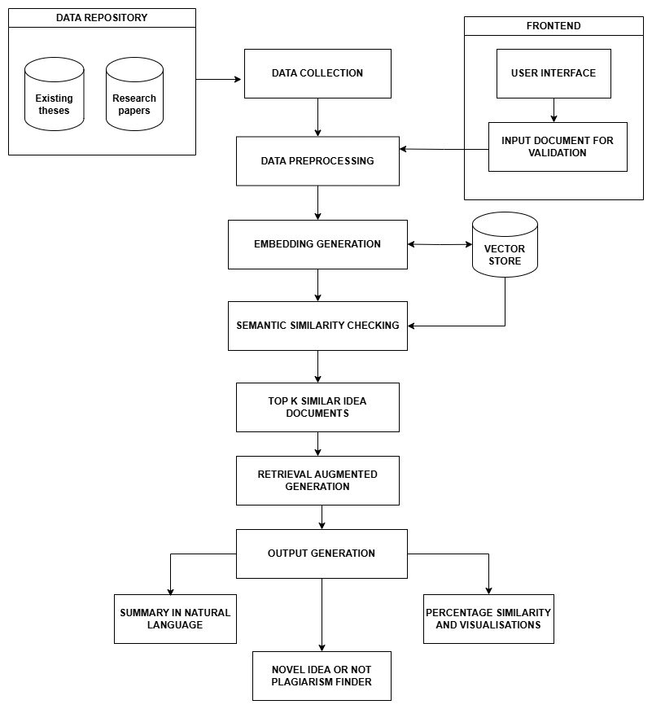

Slide 11
Detailed Design
05

Slide 12
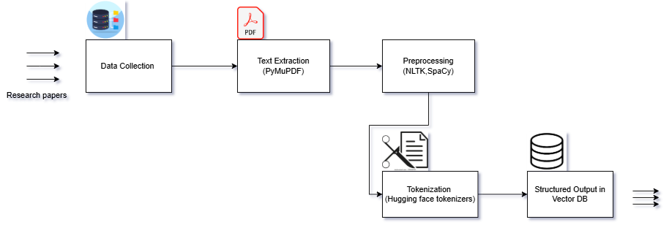
Module 1

Slide 13
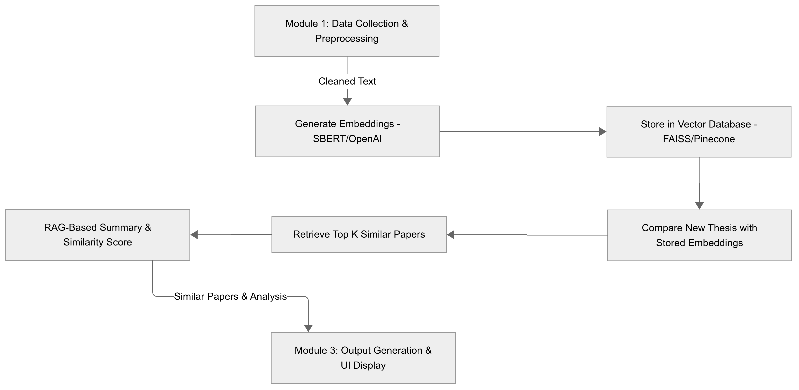
Module 2

Slide 14


Module 3
User Interface
After Analysing the uploaded paper
Plagiarism Checker
Natural Language suggestion
Concept of your paper is already there with different tech…..
🔗Upload thesis
Related papers
Thesis is novel
🔗Upload to DB
Author
Research paper
similar
Check
1
Author 1
Paper 1
90%
2
Author 2
Paper 2
50%
“Checking for plagiarism using vector DB
Sharing results

Slide 15
06
Tools and technologies

Slide 16
Tools and technologies to be used
Data processing
Data extraction : PyMuPDF
Text processing : nltk and SpaCy
Hugging face tokenizer
RAG and Embedding similarity
Sentence Transformers from HuggingFace
FAISS vector store
Conversational retrieval chain from Langchain –RAG
Llama2 – LLM
Cosine similarity – ScikitLearn
Frontend and UI
React.js
Flask

Slide 17
06
Module-Split up

Slide 18
Sivasankaramoorthy R (Data Collection & Preprocessing)
Collect & Preprocess Data – Extract, clean, and structure research papers.
Generate & Store Embeddings – Convert text to embeddings and save in a vector database.
Dharaniraj VM (Semantic Similarity & Retrieval)
Semantic Similarity Check – Compare thesis embeddings and retrieve Top K similar papers.
Retrieve Relevant Papers – Fetch matched research works for further analysis.
Jayasuriya R (UI, Visualization & RAG-Based Analysis)
Frontend & Visualization – Develop UI, display similarity scores, and create visual insights.
RAG-Based Summary & Novelty Decision – Generate explanations using RAG and determine originality.

Slide 19
Conclusion
This project provides an AI-driven EduTech solution that ensures academic integrity by validating the originality of research papers. By leveraging RAG, embeddings, and semantic similarity analysis, the system identifies conceptually similar works, helping students refine their ideas while discouraging plagiarism.
With an efficient data processing pipeline, advanced similarity detection, and an interactive UI, this solution streamlines thesis validation for institutions. Beyond plagiarism prevention, it serves as a learning tool, exposing students to research trends and fostering innovation. This project is a socially relevant initiative that bridges technology and education, promoting ethical and groundbreaking research.

